Slide 1
Essential TypeScript Plugins

Slide 2
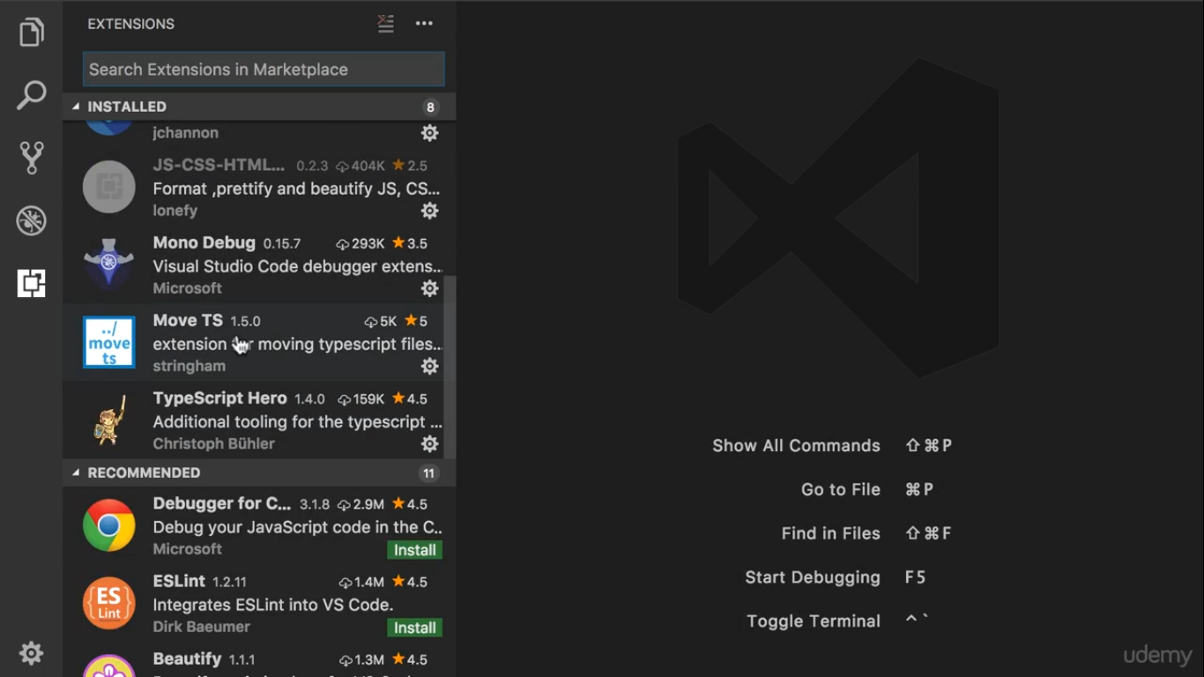
Install these two plugins

Slide 3
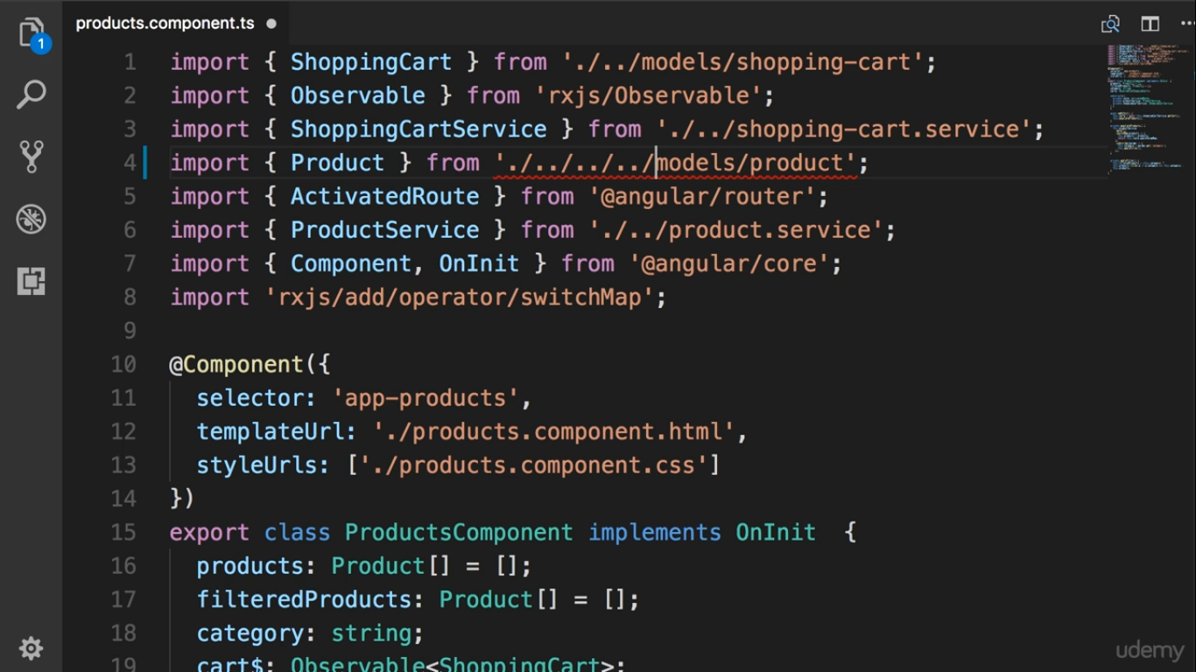
When we organize module,
this is an ugly path

Slide 4
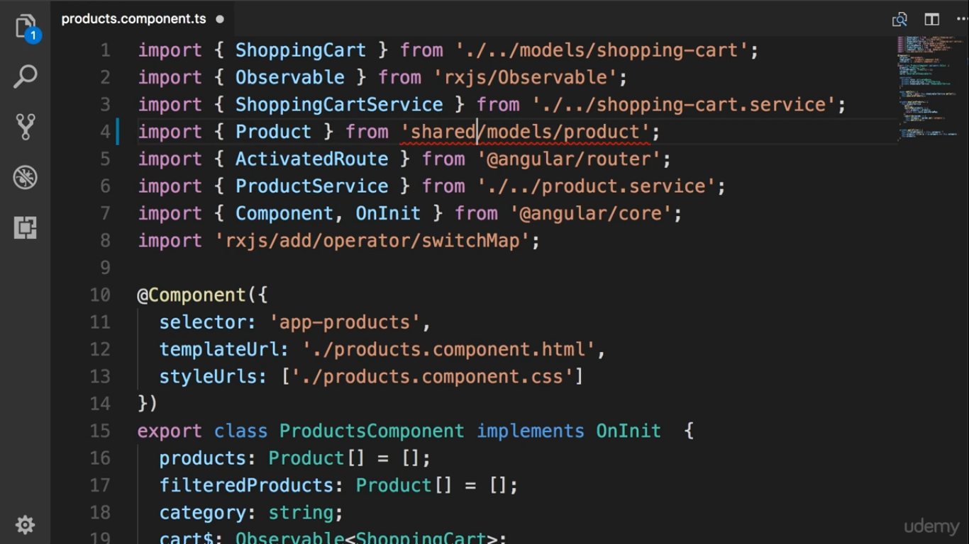
We want to define like this
so we modified our typescript
compiler

Slide 5
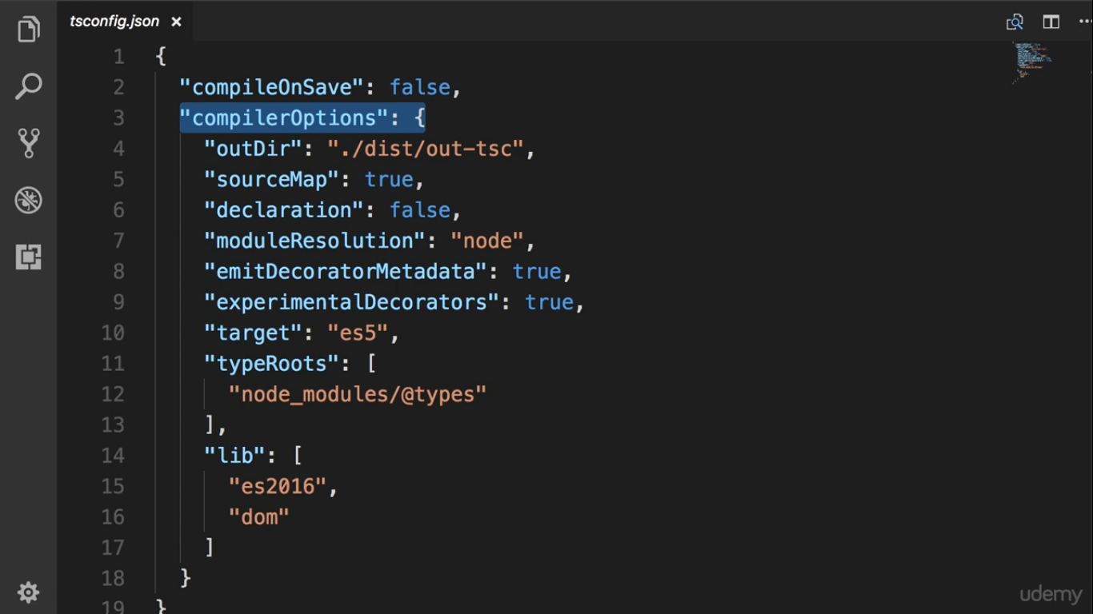

Slide 6
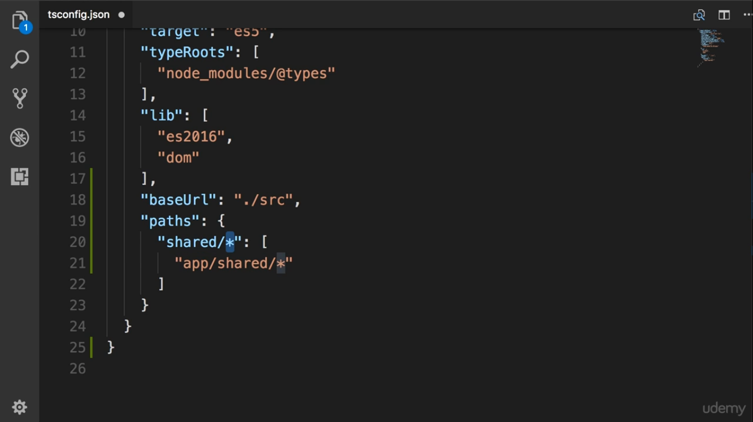
Alias of the path

